Slide 1
Visualization and usage of Topic Modeling
Patrick Keller
Jeff Meder
Maya Olszewski

Slide 2
Index
Topic Modeling
Visualization
Related Work
Our Approach
Implementation
Demo
Future Work

Slide 3
Topic Modeling
Unsupervised machine learning technique
Looks for relations in document collections
Growing amount of data -> need to visualize
Topic 1 Topic 2 Topic 3
Word
Cluster
Document 1
Document 2
Document N
…

Slide 4
Visualization
Helpful to :
better understand relations
overview the data set
extract new information and knowledge
Concise and understandable representation of (large) data set
Visualize different granularities/scopes
Different purposes of visualization:
Comparison
Composition
Distribution
Relationship

Slide 5
Small Scope: Pie, Donut, Bar Charts
Useful to represent fine grained information (details) on smaller space
E.g. repartitions of topics in a document, relevance per topics in corpus, most relevant words per topic, etc.
Not useful for higher level comparisons

Slide 6
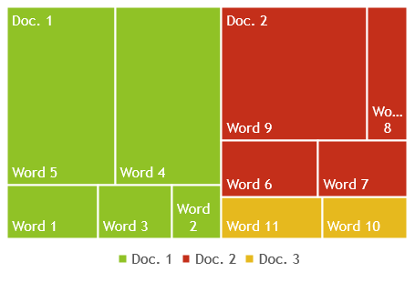
Medium Scope: Stacked Bar Chart, Tree Map Chart
Useful to represent two levels of information at once
E.g. represent topic relevance for multiple documents, of words per document, etc.
Harder to represent details (on limited space)

Slide 7
Large Scope: Network/Force Directed Graph, Bubble Chart
Useful to represent a global structure of a data set
E.g. cluster documents by most relevant topic.
Difficult to represent quantitative relations
D 5
W
W
D 3
Topic B
D 4
Topic A
W
D 2
D 3
D 1
W

Slide 8
Other Visualization Techniques
Parallel coordinate chart
Scatter plot
Heatmap
Chernoff faces
Tree chart
Box plot
Timeline chart
Flow chart
Organizational chart
And many many more ….

Slide 9
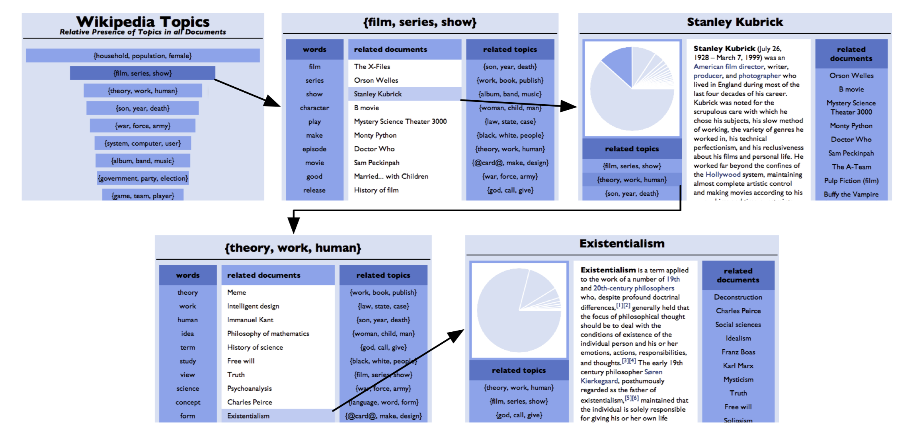
Related Work
Visualization tool by A.J.B Chaney and D.M. Blei
Wikipedia Data Set
Allows to navigate through the data set
User study shows it’s very intuitive

Slide 11
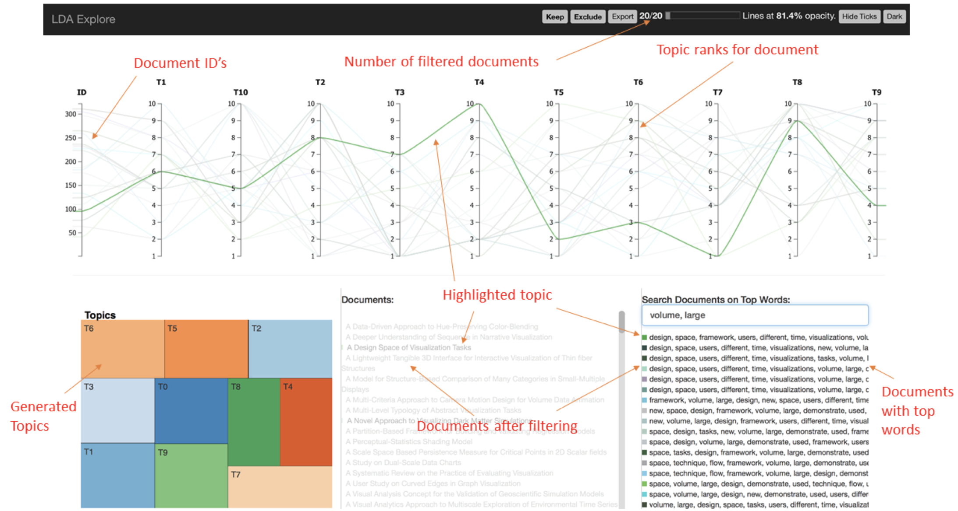
Related Work (2)
LDAExplore, a tool created by A. Ganesan, K. Brantley, S. Pan and J. Chen
Also allows to navigate through the data set
Has a multitude of selection criteria
User study shows not all features are intuitive

Slide 13
Our Approach
Navigation technique similar to the first tool
User study: first tool more intuitive
Global View of the data set:
View by topic
Most frequent word per topic
Statistics on topics distribution along the data set
Details to provide enough insight into documents:
Similar documents
Relevance of topic per document

Slide 14



Implementation
Use Java Swing to create the application
Use Mallet to perform Topic Modelling
Preprocessing
Remove of Stopwords
Stemming of tokens
Similarity of documents by Euclidean distance
Use JFreeChart to represent data as charts
3D pie-chart
Mouseover: display additional information

Slide 15
Demo

Slide 16
Future Work
Add more features to the program:
Choose number of topics in analysis
Choose number of displayed most similar documents
Choose language of data set
Choose the chart type to be displayed
Add another local document view:
Show the composition of topic per document
Show related topics

Slide 17
Questions?

